Slide 1
Network & Service Management Summer 2015 Lecture 1 – Introduction to SNMP

Slide 2
Network Management Elements
Consists of Managers and Agents.
Managers (or Management Stations)
Employ automatic or user initiated polling of managed devices.
Agents
Gather and store information about the managed resources
Provide information to Managers on demand.
Send alerts to Managers when events of interest occur.

Slide 3
Network Management Framework
An overall architecture
Consisting of manager(s) and managed devices.
A repository of managed objects
Management Information Base (MIB)
Mechanism for describing and naming managed objects and events.
Structure of Management Information (SMI)
Protocol for transferring management information.
Simple Network Management Protocol (SNMP)
A number of general-purpose/standard MIBs.

Slide 4
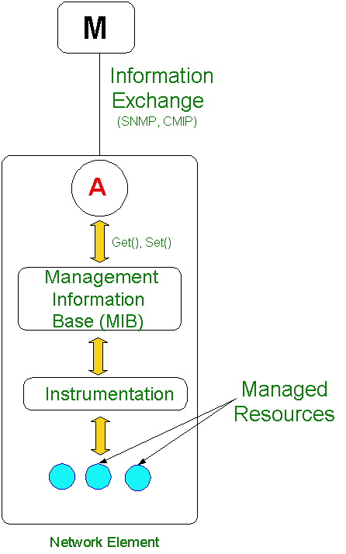
Management Information Base

Slide 5
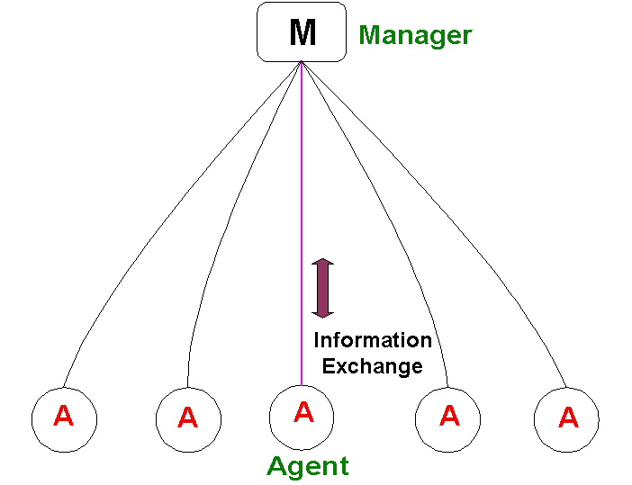
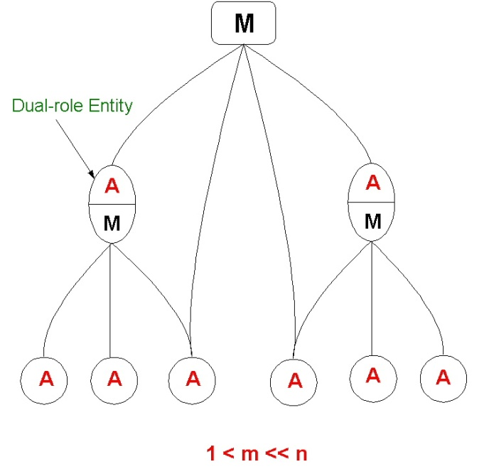
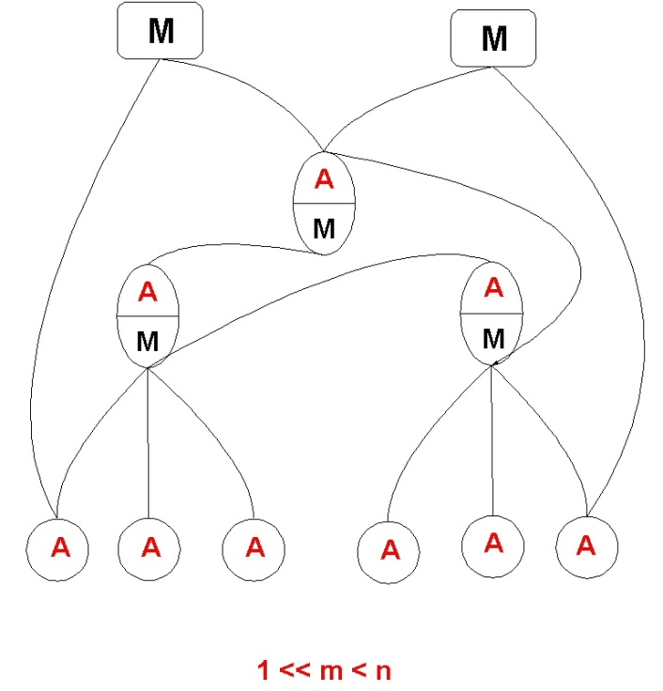
Network Management Architectures
Centralized
Weakly
Distributed
Strongly
Distributed

Slide 6
ISO Standardization
ISO WG 4
http://www.iso.org
Defined the OSI Network Management Model
Management should be powerful
Object oriented approach
Reliable exchange of management information
CMIP, MIT

Slide 7
OSI Management Model
Functional Component (FCAPS)
Fault Management
Configuration Management
Accounting Management
Performance Management
Security Management
Information Component
Management Information Tree (MIT)
Communication Component
Common Management Information Protocol (CMIP)

Slide 8
OSI Functional Component
Fault Management
Detection and recovery of network anomalies and failures.
Configuration Management
Provision network resources and services.
Accounting Management
Collect usage data for the resources used; generate associated tariff.
Performance Management
Monitor performance parameters, collect traffic statistics.
Security Management
prevention and detection of improper access/use of network resources and services

Slide 9
ITU-T Standardization
Defined the TMN framework
Uses OSI Network Management Model
Recommends out-of-band management.
Support for Operations, Administration, Maintenance, and Provisioning (OAMP) of Telecommunications networks
Logically separate network and interfaces with the Telecommunications network at several distinct point
http://www.itu.int/itu-t

Slide 10
TMN Logical Layers
Business Management
Service Management
Network Management
Element Management
Network
Elements

Slide 11
IETF Standardization
O&M Working Group
http://www.ietf.org
Defined the SNMP Management Standard
Management should be simple
Variable oriented approach
Management information exchanges may be unreliable
SNMPv1, SNMPv2c, SNMPv3
SMI, MIB

Slide 12
IETF Core SNMP RFCs
SNMP Protocol Specification
Version 1 – RFC 1157
Version 2 – RFCs 1901, 1902, 1903, 1904, 1905, 1906, 1907
Version 3 – RFCs 3411, 3412, 3413, 3414, 3415
SMI
Structure and identification of management information.
SMIv1 - RFC 1155
SMIv2 – RFC 2578
MIB-II
Managed Object definitions for TCP/IP-based internets – RFC 1213
A large number of RFCs for IETF standard MIBs

Slide 13
SNMP Management Framework
Management Station
Managed Device
Management
Application
Application
Manages Objects
Managed Resources
Managed Objects (MIB)
Get
GetNext
Trap
GetResponse
Get
GetNext
Trap
Set
GetResponse
Set
SNMP Messages
SNMP
SNMP
UDP
UDP
IP
IP
Link Layer
Link Layer

Slide 14
A Typical SNMP Agent
Implements full SNMP protocol
Stores and retrieves management data as defined by the Management Information Base
Asynchronously signals events to a manager

Slide 15
A Typical SNMP Manager
Implements full SNMP protocol
Able to:
Query agents
Get responses from agents
Set variables in agents
Acknowledge certain asynchoronous events from agents

Slide 16
Structure of Management Information (SMI)
SMI specifies a set of rules for defining managed objects.
RFC 1155 specifies SMIv1
RFC 2578 specifies SMIv2
All managed objects are arranged in a hierarchical tree structure.
An object’s location in this tree structure identifies how to access this object

Slide 17
SMIv1 Managed Object Definition
An Object type definition consists of five fields:
A textual name with its corresponding OBJECT IDENTIFIER.
SYNTAX, the object data type:
Uses a subset of the ASN.1 notation
Must resolve to a primitive data type (INTEGER, OCTET STRING, OBJECT IDENTIFIER)
Access, how the object may be accessed (read-only, read-write, write-only, or not-accessible)
Status, implementation requirement (mandatory, optional, or obsolete)
Definition, textual description of the object type.

Slide 18
SMIv1 Primitive Data Types
SYNTAX defines the data type for objects
Only the following ASN.1 primitive data types are permitted:
INTEGER
OCTET STRING
OBJECT IDENTIFIER
Enumerated INTEGERs are allowed
ASN.1 type SEQUENCE is permitted for defining tables:
SEQUENCE OF <entry>, where <entry> resolves to a list.

Slide 19
SMIv1 Managed Object Definition
sysObjectID OBJECT-TYPE
SYNTAX OBJECT-IDENTIFIER
ACCESS read-only
STATUS mandatory
DESCRIPTION
"The vendor's authoritative identification of the network management subsystem contained in the entity. This value is allocated within the SMI enterprises subtree (1.3.6.1.4.1)and provides an easy and unambiguous means for determining `what kind of box' is being managed.”
::= { system 2 }

Slide 20
SMIv1 Abstract Data Types
IpAddress
IMPLICIT OCTET STRING (SIZE(4))
4-byte OCTET STRING
TimeTicks (hundredths of seconds)
IMPLICIT INTEGER
32-bit non-negative integer (0..2³²-1)
Wraps around every 497 days
Counter (this wraps)
IMPLICIT INTEGER
32-bit non-negative integer (0..2³²-1)
Gauge (this doesn’t wrap)
IMPLICIT INTEGER
32-bit non-negative integer (0..2³²-1)

Slide 21
SMIv1 Managed Object Definition
sysUpTime OBJECT-TYPE
SYNTAX TimeTicks
ACCESS read-only
STATUS mandatory
DESCRIPTION
"The time (in hundredths of a second) since the network management portion of the system was last re-initialized."
::= { system 3 }

Slide 22
SMIv1 Managed Object Definition
ifTable OBJECT-TYPE
SYNTAX SEQUENCE OF IfEntry
ACCESS not-accessible
STATUS mandatory
DESCRIPTION
"A list of interface entries. The number of entries is given by the value of ifNumber."
::= { interfaces 2 }
ifEntry OBJECT-TYPE
SYNTAX IfEntry
ACCESS not-accessible
STATUS mandatory
DESCRIPTION
"An interface entry containing objects at the subnetwork layer and below for a particular interface."
INDEX { ifIndex }
::= { ifTable 1 }

Slide 23
SMIv1 Managed Object Definition
IfEntry ::= SEQUENCE {
ifIndex
INTEGER,
ifDescr
DisplayString,
ifType
INTEGER,
ifMtu
INTEGER,
ifSpeed
Gauge,
...
}
ifDescr OBJECT-TYPE
SYNTAX DisplayString (SIZE (0..255))
ACCESS read-only
STATUS mandatory
DESCRIPTION
"A textual string containing information about the interface. This string should include the name of the manufacturer, the product name and the version of the hardware interface."
::= { ifEntry 2 }

Slide 24
MIB Hierarchy
iso (1)
org (3)
dod (6)
[iso org (3) dod (6)]
1.3.6
internet (1) IAB
directory (1)
mgmt (2) IANA
private (4) IANA
experimental (3) IANA
Not used
[iso org (3) dod (6) internet (1) mgmt (2)]
1.3.6.1.2

Slide 25
The ‘mgmt’ node
The ‘mgmt (2)’ sub-tree is used to identify objects defined in IAB-approved documents
Administration of ‘mgmt (2)’ sub-tree delegated to IANA
When IETF/IAB approves a new Internet- standard Management Information Base (as an RFC), it is assigned an OBJECT IDENTIFIER by the IANA for identifying objects defined by that RFC.

Slide 26
The ‘private’ sub-tree
Administration of the ‘private (4)’ sub-tree is delegated by the IAB to the IANA.
The ‘private (4)’ sub-tree is used to identify objects defined unilaterally.
This sub-tree has one child:
enterprises OBJECT IDENTIFIER ::= { private 1 }
The ‘enterprises (1)’ sub-tree is used to permit enterprises to register their product models.
Upon receiving a sub-tree under ‘enterprises’, the enterprise define new MIB objects under this sub-tree.

Slide 27
SNMPv1
First Internet management standard to be published
RFC 1157 published in 1990
Widely accepted and still the most common version of SNMP
SNMPv1 supports four operations
Get, retrieve specific objects
Get-Next, retrieve objects by traversing a MIB tree
Set, modify or create objects
Trap, send unsolicited notifications to management station(s).

Slide 28
SNMPv1 - Get
Used to retrieve specific objects
A get-request for {sysUpTime.0, ifIndex.1, ifDescr.2} will return a response with variable bindings:
sysUpTime.0 287231
ifIndex.1 1
ifDescr.2 ethernet
Only leaf objects can be retrieved
Retrieving non-leaf objects will result in a response with an error status of ‘noSuchName’

Slide 29
SNMPv1 – Get-Next
Used to traverse the MIB tree
Retrieves the next leaf object in lexicographic order
A get-next request for {system, ifInUcastPkts.1, ifInNUcastPkts.1} will return a response with variable bindings:
system.SysDecr.0 “router”
ifInUcaastPkts.2 8876
ifINNUcastPkts.2 1790
Non-leaf objects can be specified

Slide 30
SNMPv1 – Set
Used to modify or create managed objects
The variable bindings specify object identifiers and the values to set them to.
Set operation is atomic – either all variables are set or none of them set.

Slide 31
SNMPv1 – Traps
The coldStart Trap
The warmStart Trap
The linkDown Trap
The linkUp Trap
The authenticationFailure Trap
The egpNeighborLoss Trap
The enterpriseSpecific Trap

Slide 32
SNMPv1 Message Structure
SNMP Message Format:
version
community
SNMP PDU
SNMP Request PDU:
type
reqid
0
0
Variable bindings
type:
0xA0 – GET
0xA1 – GETNEXT
0xA3 - SET

Slide 33
SNMPv1 Message
SNMP Response PDU:
type
reqid
es
ei
Variable bindings
type:
0xA2 – GET-RESPONSE
es (error-status):
noError (0)
tooBig (1)
noSuchName (2)
badValue (3)
readOnly (4)
genErr (5)
ei (error-index):
Position of the first variable in the request that was in error

Slide 34
SNMPv1 Trap Message
SNMP Trap PDU:
type
ent
addr
gen
spec
ts
Variable bindings
type:
0xA4 – Trap
enterprise:
Device vendor (sysObjectId)
Agent address:
IP address of the device
Generic-trap:
1 of 6 generic traps
Specific-trap:
Enterprise specific trap
Timestamp:
Value of sysUpTime when the trap was generated

Slide 35
SNMPv1 - Trap PDU
Trap-PDU ::=
IMPLICIT SEQUENCE {
enterprise -- type of object generating trap
OBJECT IDENTIFIER,
agent-addr -- address of object generating trap
NetworkAddress,
generic-trap -- generic trap type
INTEGER {
coldStart(0),
warmStart(1),
linkDown(2),
linkUp(3),
authenticationFailure(4),
egpNeighborLoss(5),
enterpriseSpecific(6) },
specific-trap
INTEGER,
time-stamp
TimeTicks,
variable-bindings
VarBindList
}

Slide 36
IETF MIB-2
MIB-2 is defined as iso.org.dod.internet.mgmt.1 (1.3.6.1.2.1)
Every device that supports SNMP MUST support MIB-2
Made up of nine groups
170 variables
Defines the variables to manage the TCP/IP protocol stack

Slide 37
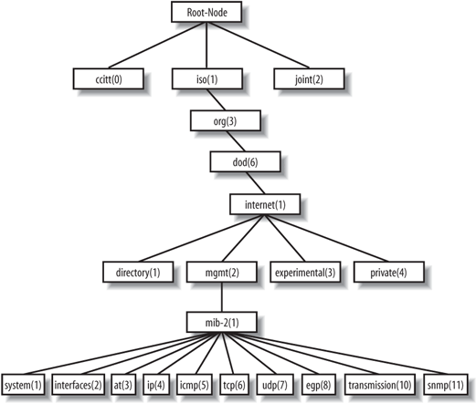
MIB-2 Subtree

Slide 38
MIB-2 Groups
Subtree Name | OID | Description
System | 1.3.6.1.2.1.1 | Defines a list of objects that pertain to system operation, such as the system uptime, system contact, and system name.
Interfaces | 1.3.6.1.2.1.2 | Keeps track of the status of each interface on a managed entity (interfaces up/down, octets sent and received, errors and discards, etc. )
at | 1.3.6.1.2.1.3 | Network to physical address translation. (deprecated, exists for backward compatibility purposes)
ip | 1.3.6.1.2.1.4 | Tracks many aspects of IP, including IP routing.
icmp | 1.3.6.1.2.1.5 | Tracks things such as ICMP errors, discards, etc.
tcp | 1.3.6.1.2.1.6 | Tracks, among other things, the state of the TCP connection
udp | 1.3.6.1.2.1.7 | Tracks UDP statistics, datagrams in and out, etc.
egp | 1.3.6.1.2.1.8 | Tracks various statistics about the Exterior Gateway Protocol (EGP) and keeps an EGP neighbor table.
transmission | 1.3.6.1.2.1.10 | No objects are currently defined for this group, but other media-specific MIBs are defined using this subtree.
snmp | 1.3.6.1.2.1.11 | Measures the performance of the underlying SNMP implementation on the managed entity and tracks things such as the number of SNMP packets sent and received.

